Slide 1


Project Management Tool
Info: https://toptechschool.us/ Email: info@toptechschool.us Phone: 206 419 7410 Add: 11235 1st Ave Seattle WA 98168

Slide 2
What is Maven
Maven is a powerful project management tool that is based on POM (project object model).
It is used for project build, dependency, and documentation. It simplifies the build process like ANT.
How to work with maven?
1: Download maven from : https://maven.apache.org/download.cgi
( download “Binary archives” not the “Source arhives”
2: Extract the zip bin folder in paste it in program files
3: then Set Up the environmental variables for Maven and the path.
https://phoenixnap.com/kb/install-maven-windows#
verify if you have install maven in your system:
mvn -version
https://maven.apache.org/guides/introduction/introduction-to-dependency-mechanism.html
Info: https://toptechschool.us/ Email: info@toptechschool.us Phone: 206 419 7410 Add: 11235 1st Ave Seattle WA 98168

Slide 3
What is POM.XML file ?
POM Files: A Project Object Model or POM is the fundamental unit of work in Maven.
Project Object Model (POM) Files are XML file that contains information related to the project and configuration information such as dependencies, source directory, plugin, goals etc. used by Maven to build the project.
When you execute a maven command you give maven a POM file to execute the commands. Maven reads pom.xml file to accomplish its configuration and operations.
What pom.xml file contains:
Project name
Properties
artifactId
groupId
version
plugin
Info: https://toptechschool.us/ Email: info@toptechschool.us Phone: 206 419 7410 Add: 11235 1st Ave Seattle WA 98168

Slide 4
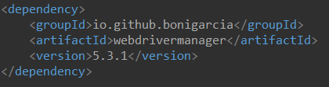
What pom.xml file contains….
project- It is the root element of the pom.xml file.
• modelVersion- modelversion means what version of the POM model you are using. Use version 4 for your maven project.
• name- this element is used to give name to our maven project.
dependencies- dependencies define a list of dependency of project. Some commonly used are (Junit, selenium-java, cucumber-java, cucumber-junit, cucumber-extentsreport, Webdrivermanager, cucumber-reporting etc)
• dependency- dependency defines a dependency and used inside dependencies tag. Each dependency is described by its groupId, artifactId and version.
• groupId- A unique name of the company or group that created the project
• artifactId- Name of the project
• version- version number of the project.
Info: https://toptechschool.us/ Email: info@toptechschool.us Phone: 206 419 7410 Add: 11235 1st Ave Seattle WA 98168

Slide 5
Maven Properties
Maven properties are value place holders. Their values are accessible anywhere within a POM by using the notation ${X}, where X is the property.
Other key words in pom.xml:
Dependencies
Dependency
Plugins
What is maven dependency
In the context of Maven, a dependency is simply a JAR file used by a Java application. Based on the POM file, Maven will download and add the JAR file to our Java path. Java will then be able to find and use the classes in the JAR file.
What is a JAR file
JAR stands for Java ARchive. It's a file format based on the popular ZIP file format and is used for aggregating many files into one.
JAR file extension is a Java archive file used for storing Java programs and games in a single file.
Info: https://toptechschool.us/ Email: info@toptechschool.us Phone: 206 419 7410 Add: 11235 1st Ave Seattle WA 98168

Slide 6
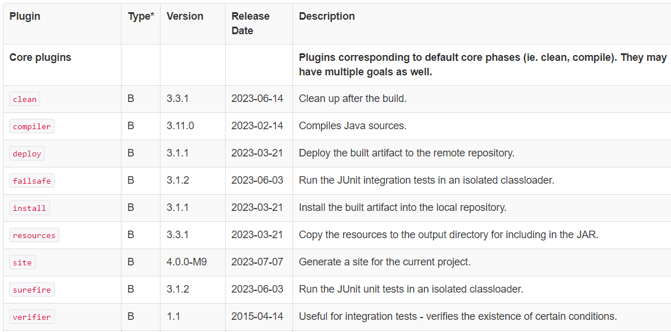
What is a maven Plugin
"Maven" is a core framework for a collection of Maven Plugins.
plugins are where much of the real action is performed, plugins are used to: create jar files, create war files, compile code, unit test code, create project documentation, and so on.
There are the build and the reporting plugins.
Build plugins are executed during the build and configured in the <build/> element.
Reporting plugins are executed during site generation and configured in the <reporting/> element.
Common plugins in pom.xml:
Compiler plugin: The Compiler Plugin is used to compile the sources of your project.
Surefire plugin: The Surefire Plugin is used during the test phase of the build lifecycle to execute the unit tests of an application.
Resources plugin: The Resources Plugin handles the copying of project resources to the output directory.
Failsafe plugin: The Failsafe Plugin is designed to run integration tests while the Surefire Plugin is designed to run unit tests. The name (failsafe) was chosen both because it is a synonym of surefire and because it implies that when it fails, it does so in a safe way.
https://maven.apache.org/plugins/
Info: https://toptechschool.us/ Email: info@toptechschool.us Phone: 206 419 7410 Add: 11235 1st Ave Seattle WA 98168

Slide 7
Build Lifecycle Basics
Maven is based around the central concept of a build lifecycle. What this means is that the process for building and distributing a particular artifact (project) is clearly defined.
There are three built-in build lifecycles:
default, clean and site.
The default lifecycle handles your project deployment,
the clean lifecycle handles project cleaning,
while the site lifecycle handles the creation of your project's web site.
Maven site lifecycle handles everything related to generating documentation for your project.
Maven default/build life cycle is divided into build phases, and the build phases are divided into build goals. Maven default/build lifecycle handles everything related to compiling and packaging your project.
Maven clean lifecycle handles everything related to removing temporary files from the output directory, including generated source files, compiled classes and previous JAR files etc.
Maven site lifecycle handles everything related to generating documentation for your project.
https://maven.apache.org/guides/introduction/introduction-to-the-lifecycle.html#build-lifecycle-basics
Introduction to the Build Lifecycle
Info: https://toptechschool.us/ Email: info@toptechschool.us Phone: 206 419 7410 Add: 11235 1st Ave Seattle WA 98168

Slide 8
A Build Lifecycle is Made Up of Phases
Each of these build lifecycles is defined by a different list of build phases, wherein a build phase represents a stage in the lifecycle.
For example, the default lifecycle comprises of the following phases (for a complete list of the lifecycle phases, refer to the Lifecycle Reference):
validate - validate the project is correct and all necessary information is available
compile - compile the source code of the project
test - test the compiled source code using a suitable unit testing framework. These tests should not require the code be packaged or deployed
package - take the compiled code and package it in its distributable format, such as a JAR.
verify - run any checks on results of integration tests to ensure quality criteria are met
install - install the package into the local repository, for use as a dependency in other projects locally
deploy - done in the build environment, copies the final package to the remote repository for sharing with other developers and projects.
These lifecycle phases (plus the other lifecycle phases not shown here) are executed sequentially to complete the default lifecycle.
Given the lifecycle phases above, this means that when the default lifecycle is used, Maven will first validate the project, then will try to compile the sources, run those against the tests, package the binaries (e.g. jar), run integration tests against that package, verify the integration tests, install the verified package to the local repository, then deploy the installed package to a remote repository.
Info: https://toptechschool.us/ Email: info@toptechschool.us Phone: 206 419 7410 Add: 11235 1st Ave Seattle WA 98168

Slide 9
Maven life cycle
• Maven Compile: compiles codes and compiler plugin is used for compilation
• Maven Test: execute test cases using Surefire Plugin
• Maven Resources: Source plugin is used. generates a Jar file when build is successful. Then, you can send this jar file to anyone.
They can use this jar file by importing it through project build path.
Info: https://toptechschool.us/ Email: info@toptechschool.us Phone: 206 419 7410 Add: 11235 1st Ave Seattle WA 98168

Slide 10
What is Packaging in Maven?
The packaging type is an important aspect of any Maven project. It specifies the type of artifact the project produces. Generally, a build produces a jar, war, pom, or other executable.
Maven produces artefacts, and the "maven package" goal is the one that will compile the code, gather the resources, run the unit tests and build a deployable artefact (JAR, WAR, EAR, etc.).
The products of Maven are always written to the "target" directory. "mvn clean will erase these products, so to build a package using the command ; use "mvn clean package“ or mvn package –Dmaven.test.skip
"packaging jar" means quite simply that the goal is to produce a jar file in the target directory. "packaging war" would build a WAR file.
Default Packaging Types
Maven offers many default packaging types that include a jar, war, ear, pom, rar, ejb etc.
Each packaging type follows a build lifecycle that consists of phases.
Usually, every phase is a sequence of goals and performs a specific task.
Java archive – or jar – is one of the most popular packaging types. Projects with this packaging type produce a compressed zip file with the .jar extension. It may include pure Java classes, interfaces, resources, and metadata files.
Info: https://toptechschool.us/ Email: info@toptechschool.us Phone: 206 419 7410 Add: 11235 1st Ave Seattle WA 98168

Slide 11
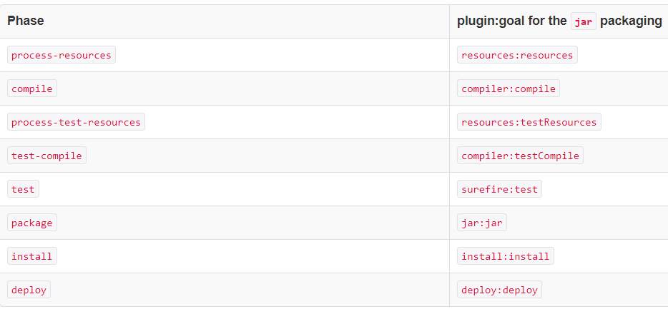
Packaging….
The first, and most common way, is to set the packaging for your project via the equally named POM element <packaging>. Some of the valid packaging values are jar, war, ear and pom. If no packaging value has been specified, it will default to jar.
Each packaging contains a list of goals to bind to a particular phase. For example, the jar packaging will bind the following goals to build phases of the default lifecycle.
let's define the packaging type of a jar project:
<packaging>jar</packaging>
Info: https://toptechschool.us/ Email: info@toptechschool.us Phone: 206 419 7410 Add: 11235 1st Ave Seattle WA 98168

Slide 12
Maven Commands
mvn clean: Cleans the project and removes all files generated by the previous build.
mvn compile: Compiles source code of the project.
mvn test-compile: Compiles the test source code.
mvn test: Runs tests for the project.
mvn package: Creates JAR or WAR file for the project to convert it into a distributable format.
mvn install: Deploys the packaged JAR/ WAR file to the local repository.
mvn site: generate the project documentation.
mvn validate: validate the project’s POM and configuration.
mvn deploy: Copies the packaged JAR/ WAR file to the remote repository after compiling, running tests and building the project.
mvn archetype:generate: This command is used to generate a new project from an archetype, which is a template for a project. This command is typically used to create new projects based on a specific pattern or structure.
mvn clean install -DskipTests=true compilation without execution.
mvn dependency:tree: This command is used to display the dependencies of the project in a tree format. This command is typically used to understand the dependencies of the project and troubleshoot any issues.
Maven follows a sequential order to execute the commands where if you run step n, all steps preceding it (Step 1 to n-1) are also executed. For example – if we run the Installation step (Step 7), it will validate, compile, package and verify the project along with running unit and integration tests (Step 1 to 6) before installing the built package to the local repository.
Info: https://toptechschool.us/ Email: info@toptechschool.us Phone: 206 419 7410 Add: 11235 1st Ave Seattle WA 98168

Slide 13
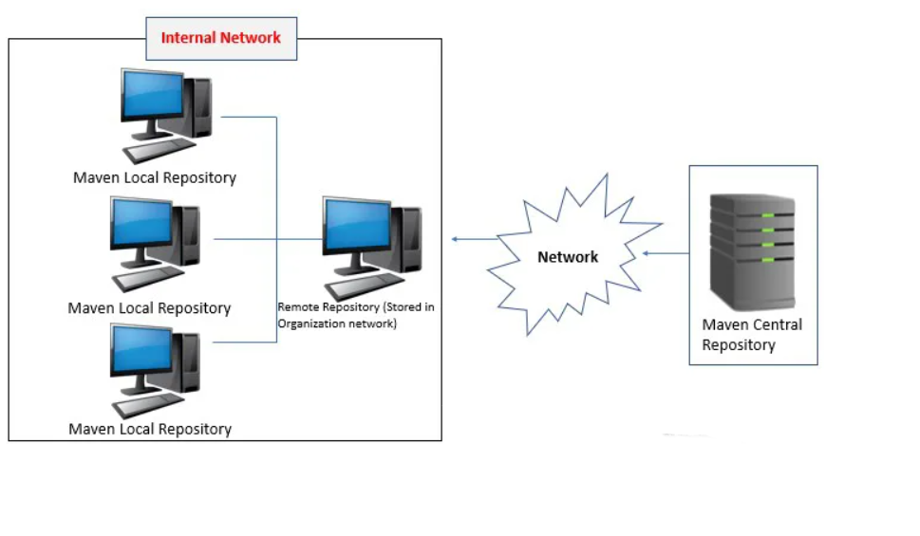
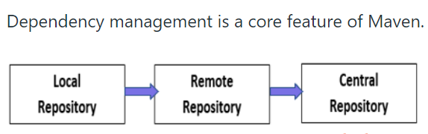
Types of Repositories
Consider the following to understand the types and where they are stored.
Maven repository
Maven repository is a directory where all the packages, JAR files, plugins or any other artifacts are stored with POM.xml. Repository in maven holds build artifacts and dependencies of various types. It provides three types of repositories.
Maven has three types of repository:
1. Local repository
2. Central repository
3. Remote repository
Info: https://toptechschool.us/ Email: info@toptechschool.us Phone: 206 419 7410 Add: 11235 1st Ave Seattle WA 98168

Slide 14
1. Local Repositories
Maven local repository is located in the local computer system.it is created by maven when the user runs any maven command. The default location is %USER_HOME%/.m2 directory. When maven build is executed, Maven automatically downloads all the dependency jars into the local repository. For new version maven will download automatically. If version declared in the dependency tag in POM.xml file it simply uses it without downloading. By default, maven creates local repository under %UESR_HOME% directory.
2. Remote Repository
This is stored in the organization’s internal network or server. The company maintains a repository outside the developer’s machine and are called as Remote Repository.
Central Repositories
This repositories are located on the web. It has been created by the apache maven itself.it contains a large number of commonly used libraries. It is not necessary to configure the maven central repository URL. Internet access is required to search and download the maven central repository.
Info: https://toptechschool.us/ Email: info@toptechschool.us Phone: 206 419 7410 Add: 11235 1st Ave Seattle WA 98168

Slide 15
How to Run Test Cases
We can run our test cases using Test Runner class in Eclipse
we can run our test cases by right click on the pom and or on the Project and Run As …
We can also run our test cases using command prompt with the using maven commands:
We can run our test cases using batch file ( create a file in your project with extension .bat copy the followings :
Cd <your project path>
Mvn clean install
( click the file and the test case will be run)
5. We can run our test cases using Jenkins( you need to configure Jenkins in your machine)
Note: In order to Run Test cases using command prompt, you should set up environment variables for maven first as follows:
Download maven and setup environment variables:
System variables -> path ->edit -> new -> paste the path upto bin folder
System variables -> new -> MAVEN_HOME & maven path
System variables - > M2_HOME & maven path( good when working with Jenkins)
And edit environment variables too:
Info: https://toptechschool.us/ Email: info@toptechschool.us Phone: 206 419 7410 Add: 11235 1st Ave Seattle WA 98168

Slide 16
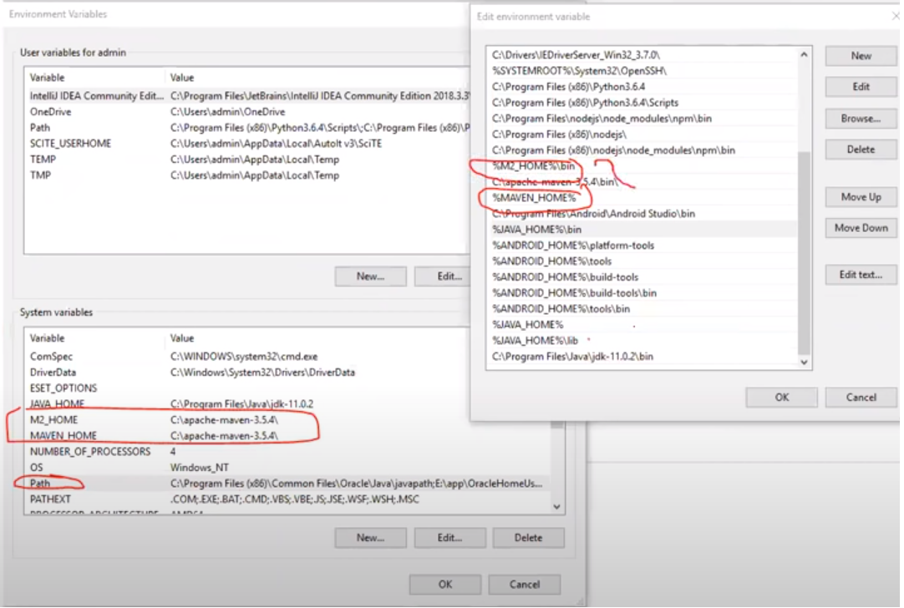
Set up environment variables
Info: https://toptechschool.us/ Email: info@toptechschool.us Phone: 206 419 7410 Add: 11235 1st Ave Seattle WA 98168

