Slide 1
HTML Introduction
HTML IS MARKUP LANGUAGE

Slide 2
What is Markup Language?
SHORT ANSWER:
codes embedded in files for formatting
It is in every text processing tool: Word, Excel, PowerPoint, Access, HTML and others

Slide 3
What is Markup Language?
LONGER ANSWER:
It's a collection of codes that explain the meaning or desired formatting of the marked text
It's a way of describing, using instructions buried in the document, what the document is supposed to look like
Every electronic text processing tool uses some kind of markup language, (usually XML) though you may not necessarily be able to see the commands

Slide 4
What is Markup Language?
TLDR ANSWER:
Embedded, hidden, formatting codes in most text based documents (i.e. xml, html)

Slide 5
Markup Language helps with Interoperability (COPY Paste Word>Ppoint)
So standardization in mark up language facilitates the movement of text and graphics between different applications
You can export html out of Microsoft Word, but it adds a lot of extra code that you do not need. You can also paste HTML into Word, but you don’t see the html when you copy and paste it.
Markdown is simply short-hand for html. The markdown code is processed into html by JavaScript or PHP or other any other programming language that can transform text.

Slide 6
Html basics

Slide 7
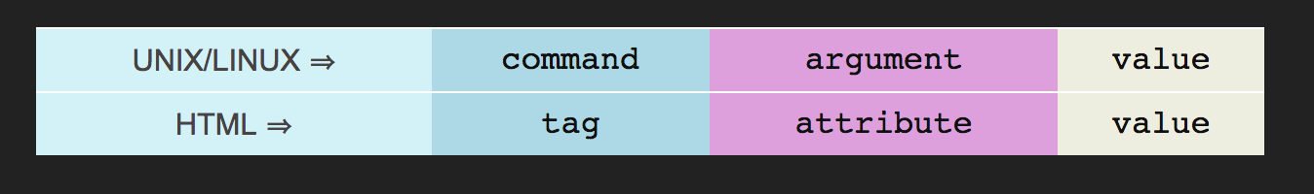
HTML follows the same three-part-instruction model we used in command line situations PLUS some inner HTML
user$
ls
-al
*

Slide 8
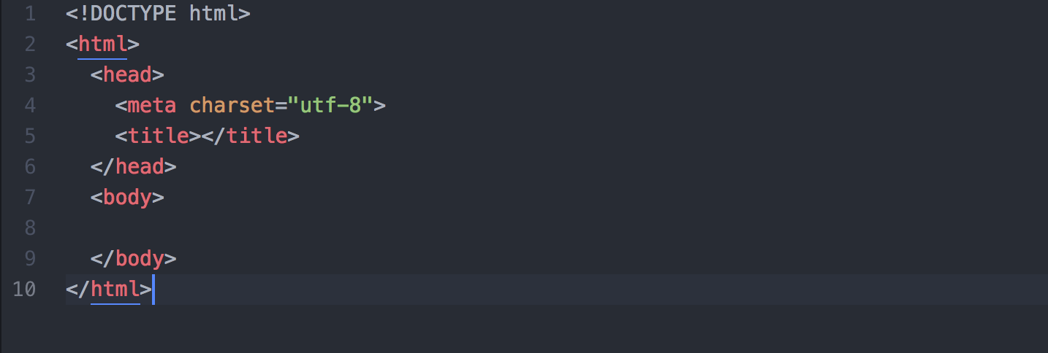
HTML Page Structure; all markup, no data
HINT: FILE MUST END IN .html
for code to show up in colors in Atom editor. If you start coding in an unsaved file, all the text will be white.
(Atom Screen shot)

Slide 9
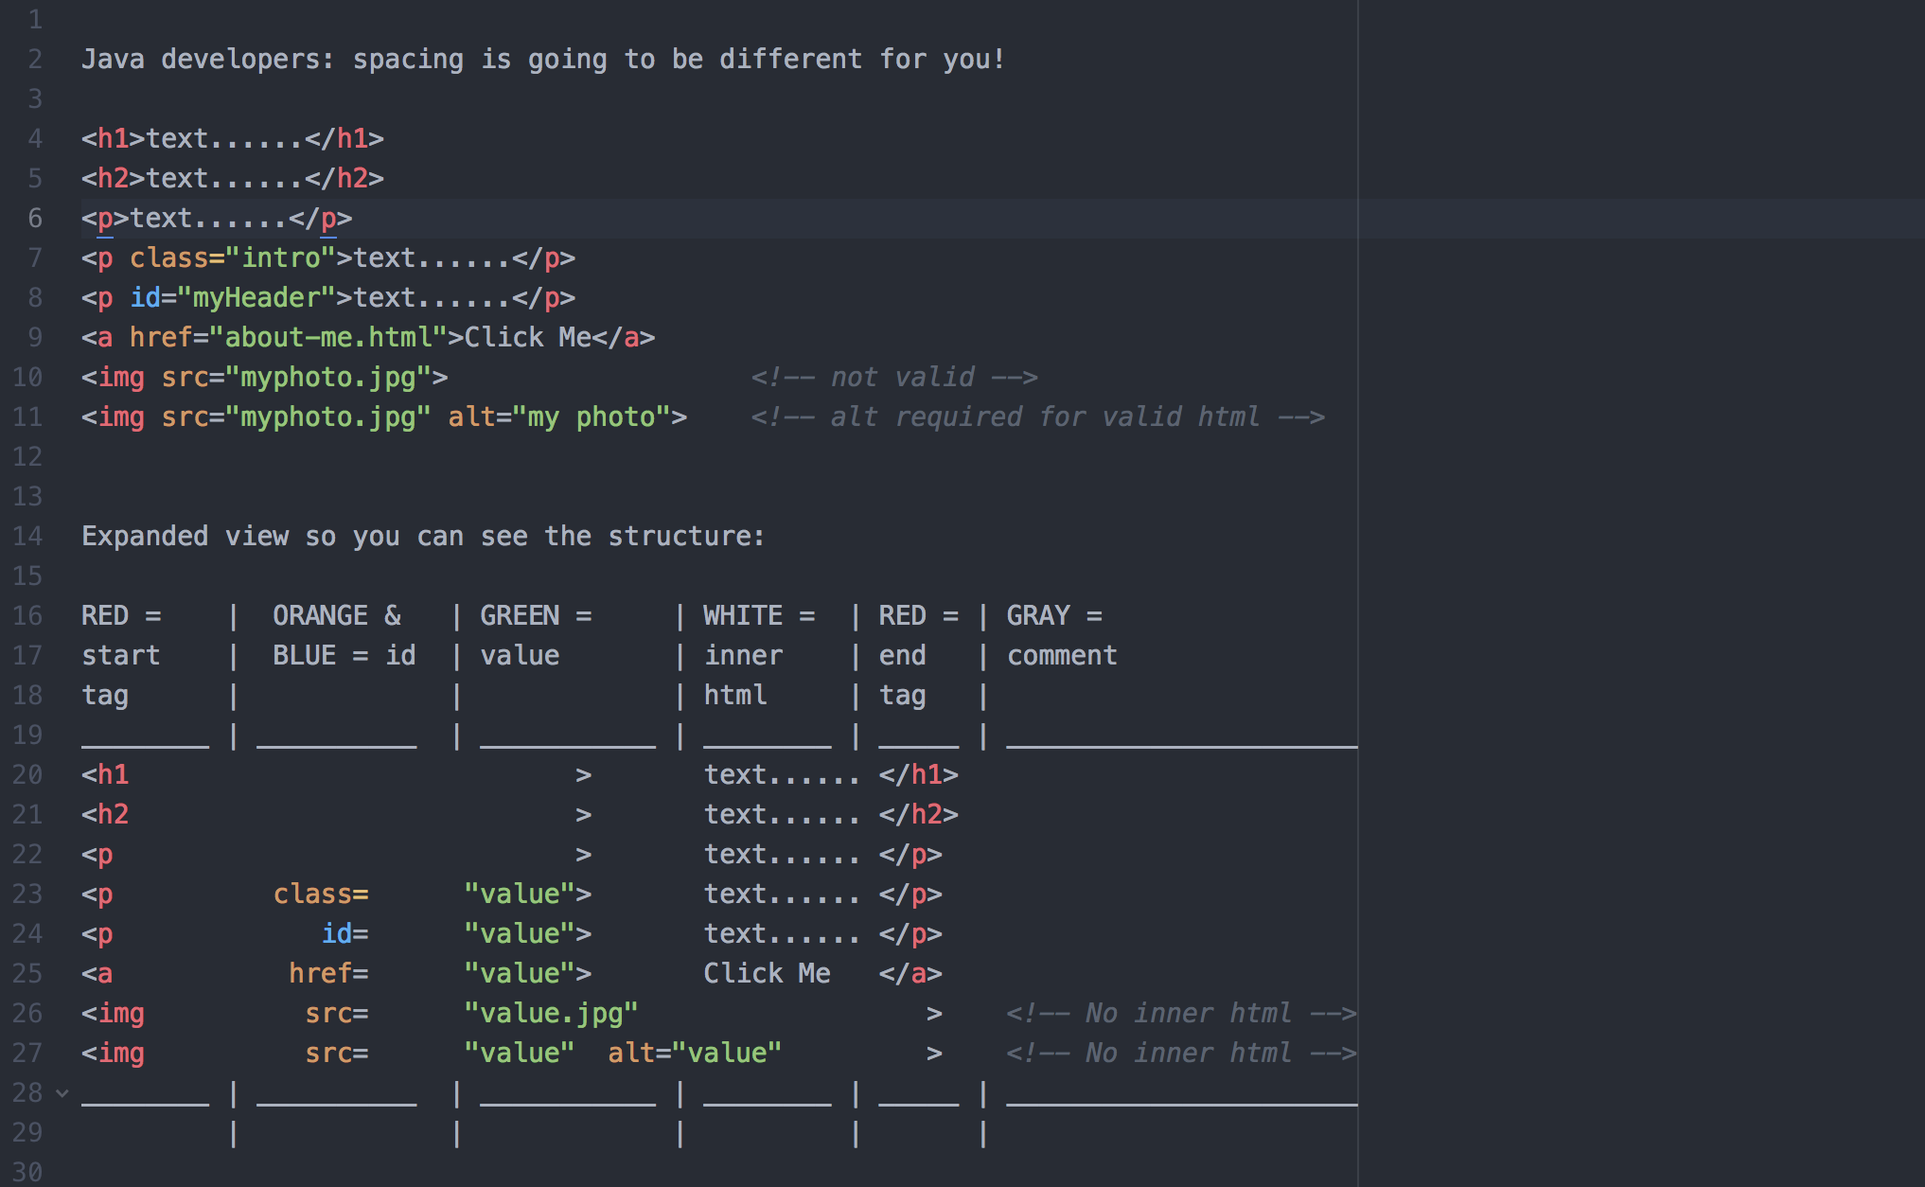
Command
Inner HTML
Value
Attribute
Command
Value
Command
Inner HTML
Attribute

