Slide 1

U-X

Slide 2
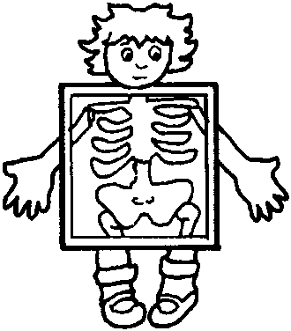
Uu
Vv
Ww
Xx

Slide 3
umbrella
Uu
up

Slide 4
van
Vv
volcano

Slide 5
watch
Ww
wig

Slide 6

x-ray
Xx
fox

