Slide 1


A-Z

Slide 2

Aa
Bb
Cc
Dd

Slide 3
Ee
Ff
Gg
Hh

Slide 4
Ii
Jj
Kk
Ll

Slide 5
Mm
Nn
Oo
Pp

Slide 6
Qq
Rr
Ss
Tt

Slide 7
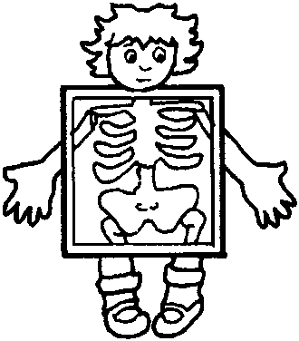
Uu
Vv
Ww
Xx

Slide 8
Yy
Zz

Slide 9



