Slide 1
Topics: CSS Responsive
Viewport
Media Queries
Images & Videos

Slide 2
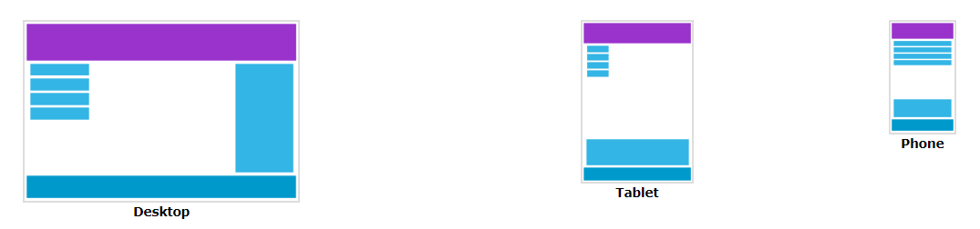
Responsive Web Design - Introduction
Designing For The Best Experience For All Users
Web pages can be viewed using many different devices: desktops, tablets, and phones. Your web page should look good, and be easy to use, regardless of the device.
What is Responsive Web Design?
Responsive web design makes your web page look good on all devices.
Responsive web design uses only HTML and CSS.
Responsive web design is not a program or a JavaScript.
Web pages should not leave out information to fit smaller devices, but rather adapt their content to fit any device:

Slide 3
What is The Viewport?
The viewport is the user's visible area of a web page.
The viewport varies with the device, and will be smaller on a mobile phone than on a computer screen.
Before tablets and mobile phones, web pages were designed only for computer screens, and it was common for web pages to have a static design and a fixed size.
Then, when we started surfing the internet using tablets and mobile phones, fixed size web pages were too large to fit the viewport.
To fix this, browsers on those devices scaled down the entire web page to fit the screen.

Slide 4
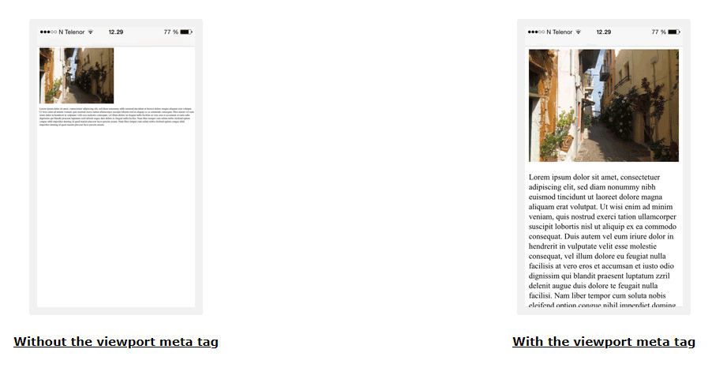
Here is an example of a web page without the viewport meta tag, and the same web page with the viewport meta tag:

Slide 5
What is a Media Query?
Media query is a CSS technique introduced in CSS3.
It uses the @media rule to include a block of CSS properties only if a certain condition is true.
Example:
If the browser window is 600px or smaller, the background color will be lightblue:
@media only screen and (max-width: 600px) {
body {
background-color: lightblue;
}
}

Slide 6
Always Design for Mobile First
Mobile First means designing for mobile before designing for desktop or any other device (This will make the page display faster on smaller devices).
This means that we must make some changes in our CSS.
Instead of changing styles when the width gets smaller than 768px, we should change the design when the width gets larger than 768px. This will make our design Mobile First:

Slide 7
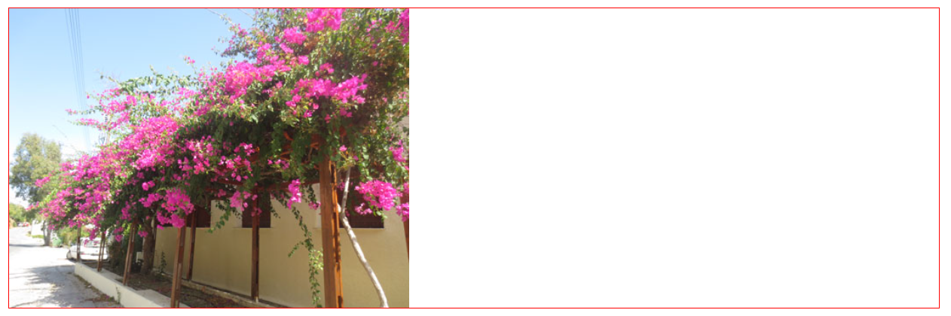
Background Images
Background images can also respond to resizing and scaling.
Here we will show three different methods:
1. If the background-size property is set to "contain", the background image will scale, and try to fit the content area. However, the image will keep its aspect ratio (the proportional relationship between the image's width and height):
Example
div {
width: 100%;
height: 400px;
background-image: url('img_flowers.jpg');
background-repeat: no-repeat;
background-size: contain;
border: 1px solid red;
}

Slide 8
Responsive WD - Videos
Using The width Property
If the width property is set to 100%, the video player will be responsive and scale up and down:
Example
video {
width: 100%;
height: auto;
}
Using The max-width Property
If the max-width property is set to 100%, the video player will scale down if it has to, but never scale up to be larger than its original size:
Example
video {
max-width: 100%;
height: auto;
}

