Slide 1
BSK YFHPI DATABASE
How to Enter a Family and Connect them FROM THE BEGINNING

Slide 2
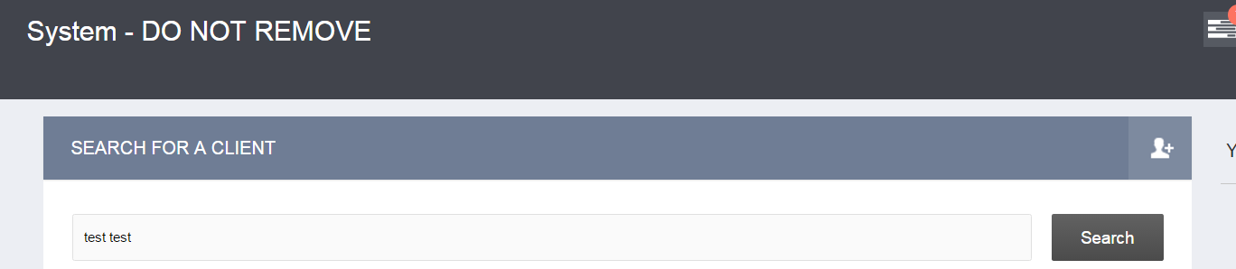
STEP ONE
ADD a new client

Slide 3
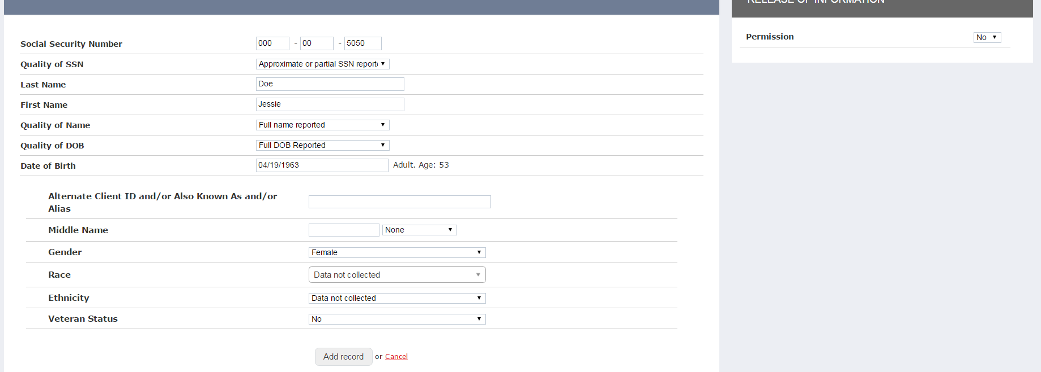
STEP TWO
Create a New Client
ADD RECORD

Slide 4
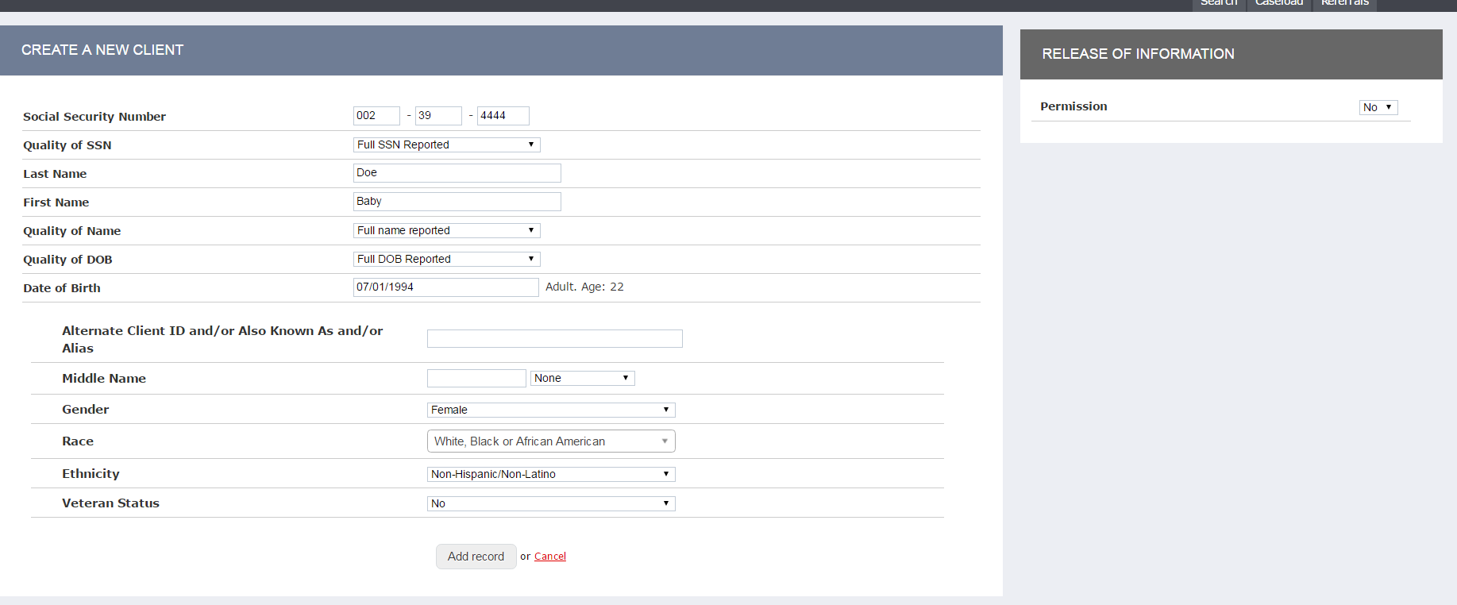
STEP THREE
Add child(ren)
ADD RECORD

Slide 5
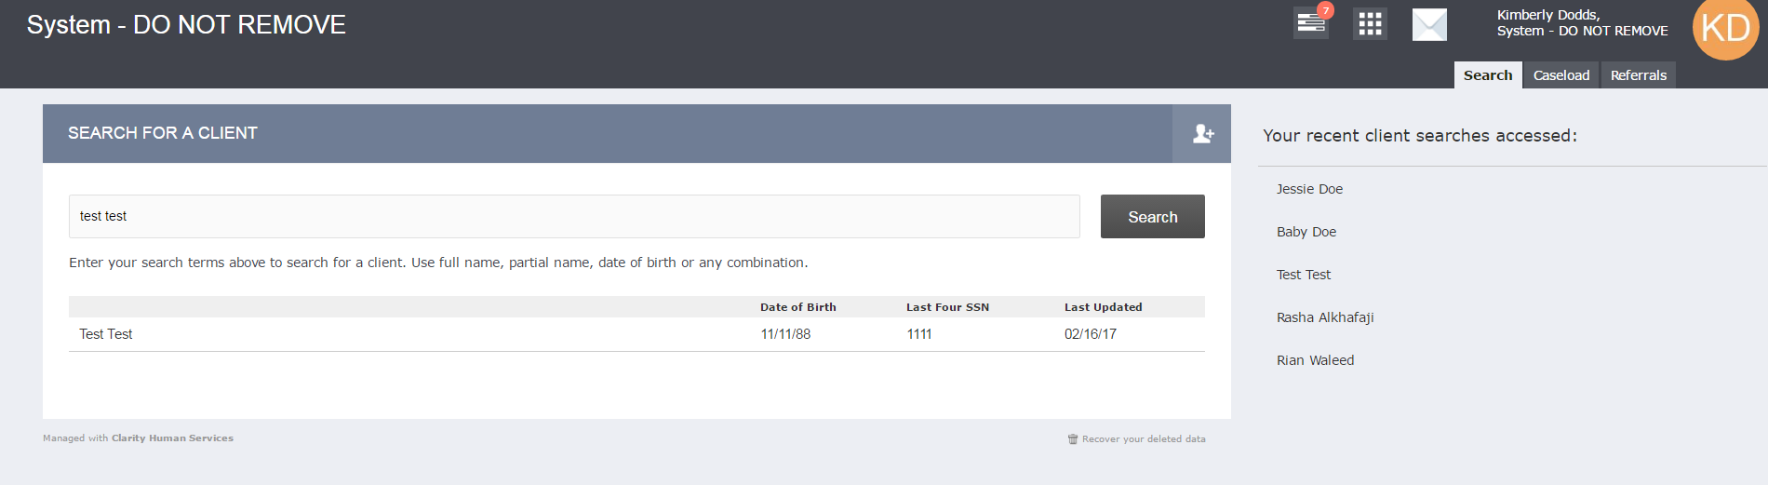
STEP FOUR
Go back to the parent’s profile
Search – Jessie Doe

Slide 6
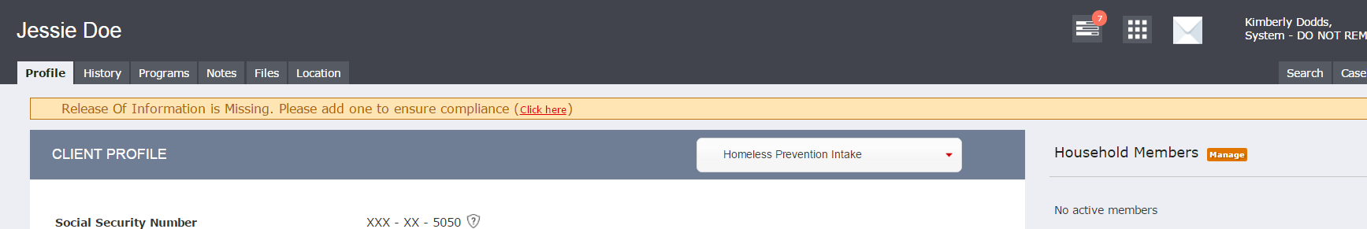
STEP FIVE
Select Parent and Household Members

Slide 7
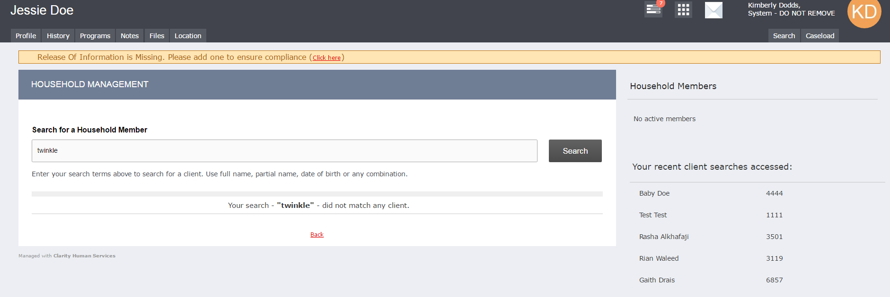
STEP SIX
Household Members – see child under “Your recent client searches accessed – AND CLICK ADD on the right!

Slide 8
STEP SEVEN
Add To Household
1. Set Member Type
2. Save!!

Slide 9
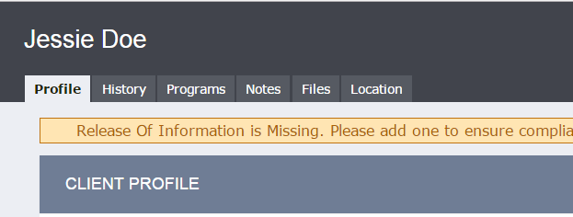
STEP EIGHT
Now enroll the parent in a program!
Profile - Program

Slide 10
STEP NINE
Programs Available
SELECT YOUR PROGRAM!!

Slide 11

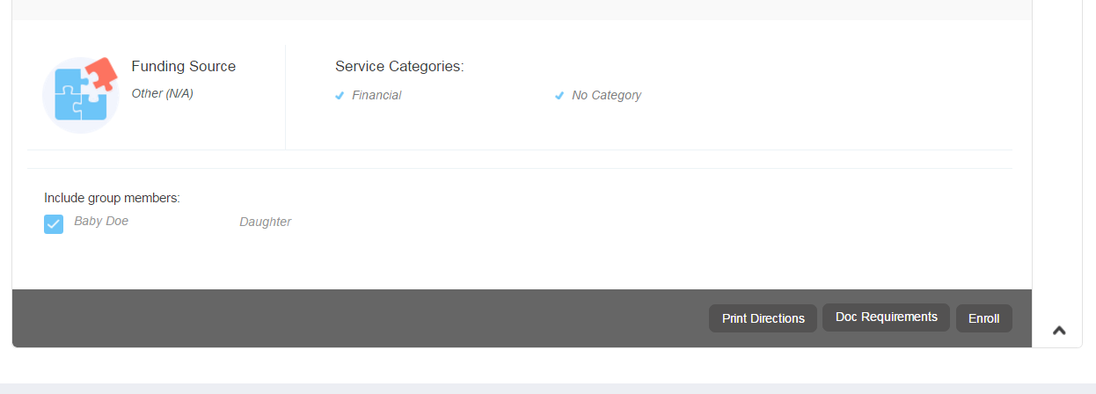
STOP….CAUTION….CAUTION….
Here is the step most people miss!!!
Do not CLICK ENROLL – until you “include group members!!

Slide 12

DID YOU CHECK INCLUDE GROUP MEMBERS? ARE ALL KIDS AND FAMILY MEMBERS CHECKED?
NOW click Enroll!!

